Slide 1
Classifying online news sources by their level of sarcasm / irony
Matei Chiperi
Mihai Daniel Colceag
Mihai Raulea

Slide 2
Road Map
Introduction
Levels of Analysis
The Lexicon and its issues
Applications of Sentiment Analysis
Sarcasm detection

Slide 3
Introduction
Sentiment Analysis (~ Opinion Mining) :
studies evaluations, attitudes, opinions and emotions regarding different products, subjects, issues, topics.
First interest:
little time before 2000 in
Sentiment analysis: Capturing favorability using natural language processing (Nasukawa and Yi, 2003)

Slide 4
Levels of Analysis
Document Level:
one opinion on main subject.
Supervised: SVM, Naïve Bayes, Logistic Regression, or KNN
Unsupervised: semantic orientation(SO), Point Mutual Information PMI(P,W)
Sentence Level:
each sentence expressed a positive, neutral or negative sentiment
objective sentences: factual information
subjective sentences: opinions and subjective views
Entity and Aspect Level:
opinion itself consisting of a target and a sentiment (positive or negative)
regular opinion: particular entity or an aspect of the entity
comparative opinion: compares multiple entities by their aspects

Slide 5
Lexicon and Issues
Sarcastic sentences with or without sentiment words:
“What a great car! It stopped working in two days.”
Not so common in reviews about products and services
Very common in political discussions, which make political opinions hard to deal with

Slide 6
Applications
Consumer Products and Services.
automatic product reviews.
Google Product Search
Financial Markets:
The Stock Sonar: sentiment about each stock alongside the graph of the price of the stock
StockTwits: shows all tweets that contain at least one stock ticker in them

Slide 7
Sarcasm Detection
Sarcasm - sophisticated form of speech in which the speakers convey their messages in an implicit way
Hard to detect - even by humans
Words express the opposite meaning
Usually depends on context
Potentially useful for detecting negative feelings about products, marketing campaigns etc.

Slide 8
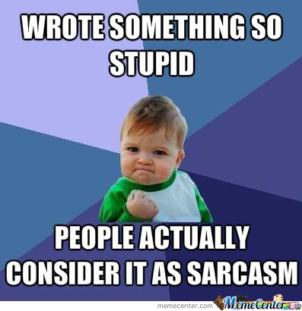

Slide 9
Tsur et al., Semi-Supervised Recognition of Sarcastic Sentences in Twitter and Amazon
Semi-Supervised Sarcasm Recognition Method
Amazon reviews & Tweet messages (#sarcasm)
Easier to detect sarcasm (positive words vs bad star rating, #hashtags etc)
Two types of features: phrase pattern and punctuation
kNN-weighted classifier

Slide 10
Pattern based features
Pattern: ordered sequence of high frequency words and slots for content words.
High Frequency Words
Content Words
One phrase: 2-6 HFW + 1-5 CW
Exact / Sparse / Incomplete / No match between patterns

Slide 11
Punctuation features
Number of !
Number of ?
Number of quotes
Number of CAPITALIZED words / letters

Slide 12
Algorithm
Training samples -> create a vector space
Each training sample labeled on a scale from 1 to 5 on sarcasm level
Extract features from test sentence
weighted-kNN classifier

